Slide 1
CSE 517: Artificial Intelligence
Chapter 8: Perception
Spring Semester 2015
Department of Computer Science and Engineering (CSE)

Slide 2
Contents
Perception
Image Formation
Image Processing
Computer Vision
Representation and Description
Object Recognition
Note…some of these images are from Digital Image Processing 2nd edition by Gonzalez and Woods

Slide 3
Perception
Perception provides an agent with information about the world they inhabit
  Provided by sensors
    Anything that can record some aspect of the environment and pass it as input to a program
      Simple 1 bit sensors…Complex human retina

Slide 4
Perception
There are basically two approaches for perception
  Feature Extraction
    Detect some small number of features in sensory input and pass them to their agent program
    Agent program will combine features with other information
    “bottom up”
  Model Based
    Sensory stimulus is used to reconstruct a model of the world
    Start with a function that maps from a state of the world to a stimulus
    “top down”

Slide 5
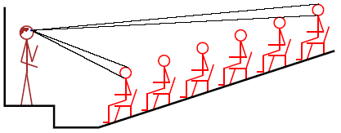
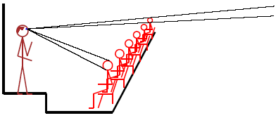
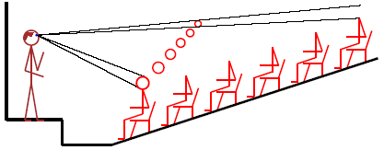
Perception
S = g(W)
  Generating S from g and a real or imaginary world W is accomplished by computer graphics
W = g⁻¹(S)
  Computer vision is in some sense the inverse of computer graphics
    But not a proper inverse…
      We cannot see around corners and thus we cannot recover all aspects of the world from a stimulus

Slide 6
Perception
In reality, both feature extraction and model-based approaches are needed
  Not well understood how to combine these approaches
  Knowledge representation of the model is the problem

Slide 7
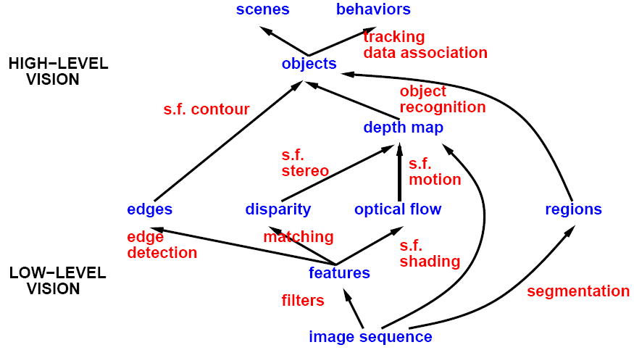
A Roadmap of Computer Vision

Slide 8
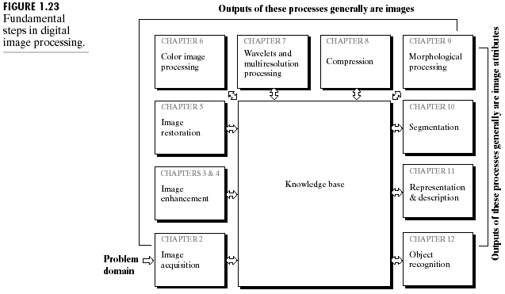
Computer Vision Systems

Slide 9
Image Formation
An image is a rectangular grid of data of light values
  Commonly known as pixels
Pixel values can be…
  Binary
  Gray scale
  Color
  Multimodal
    Many different wavelengths (IR, UV, SAR, etc)

Slide 10
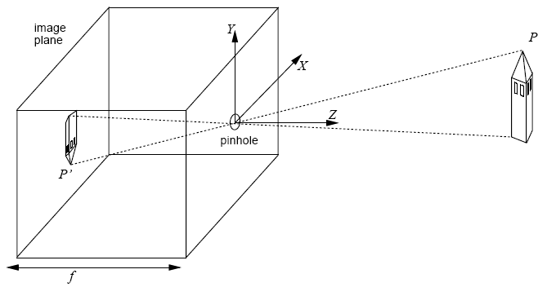
Image Formation

Slide 11
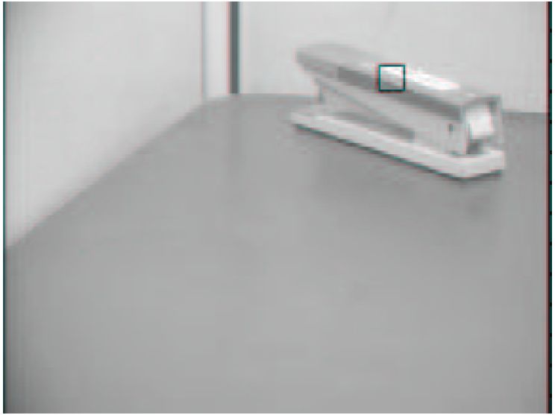
Image Formation

Slide 12

Image Formation

Slide 13
Image Formation
I(x,y,t) is the intensity at (x,y) at time t
CCD camera has approximately 1,000,000 pixels
Human eyes have approximately 240,000,000 “pixels”
  i.e. 0.25 terabits / second
Read pages 865-869 in textbook “lightly”

Slide 14

Image Formation

Slide 15
Image Processing
Image processing operations often apply a function to an image and the result is another image
  “Enhance the image” in some fashion
  Smoothing
  Histogram equalization
  Edge detection
Image processing operations can be done in either the spatial domain or the frequency domain

Slide 16
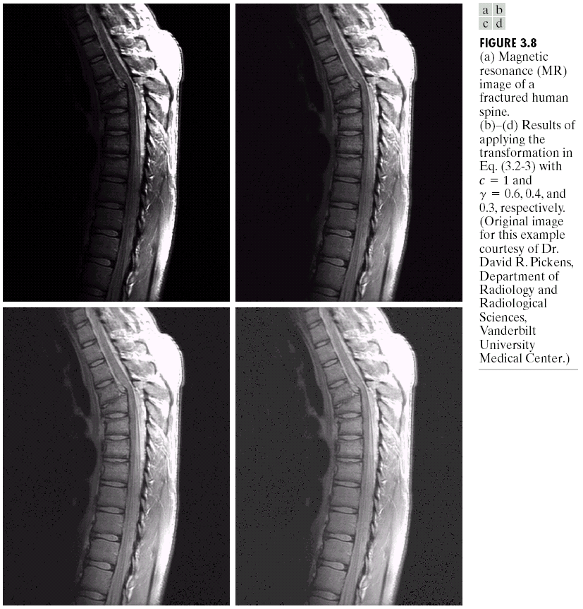
Image Processing

Slide 17
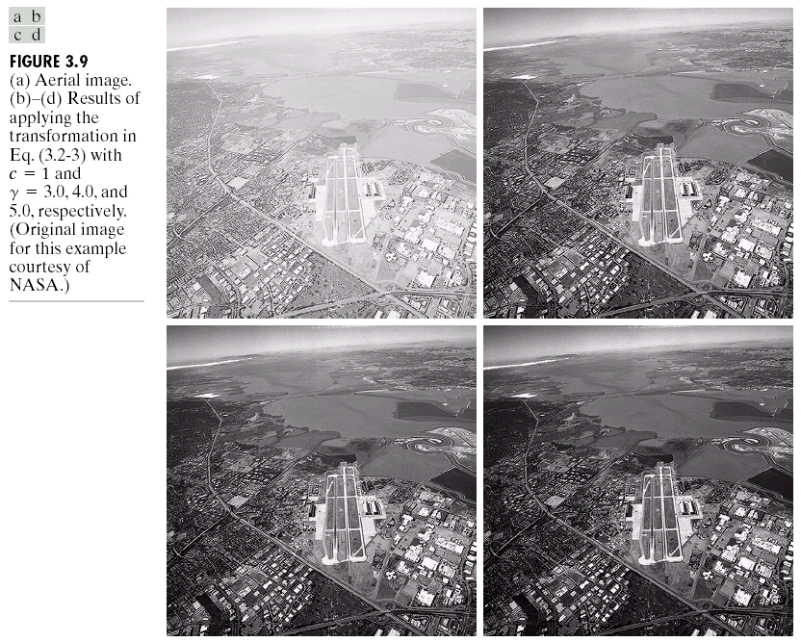
Image Processing

Slide 18
Image Processing
Image data can be represented in a spatial domain or a frequency domain
The transformation from the spatial domain to the frequency domain is accomplished by the Fourier Transform
By transforming image data to the frequency domain, it is often less computationally demanding to perform image processing operations

Slide 19
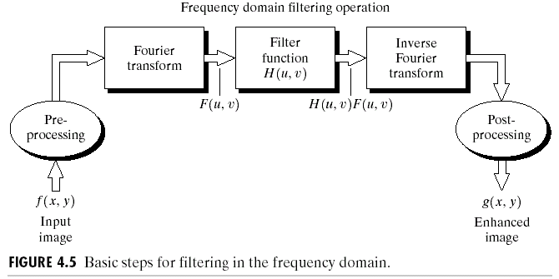
Image Processing

Slide 20
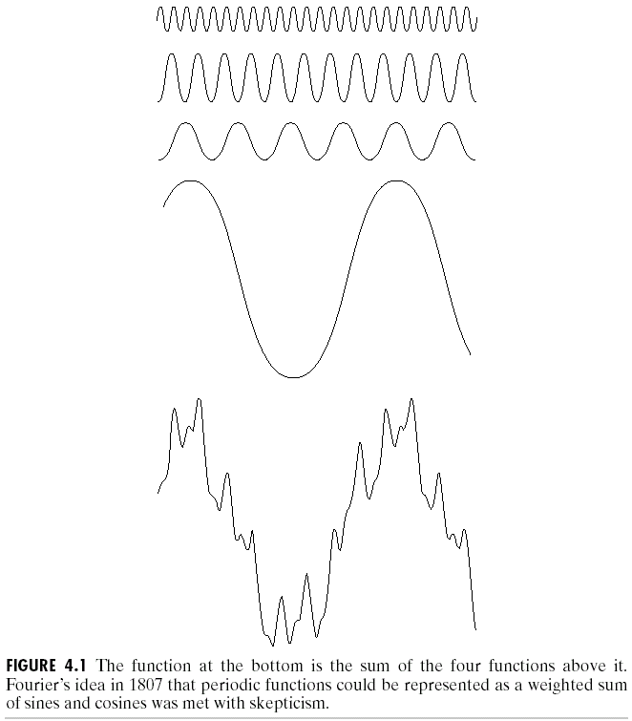
Image Processing

Slide 21
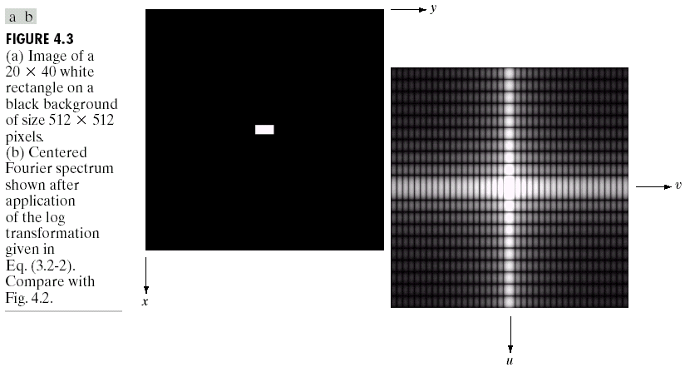
Image Processing

Slide 22
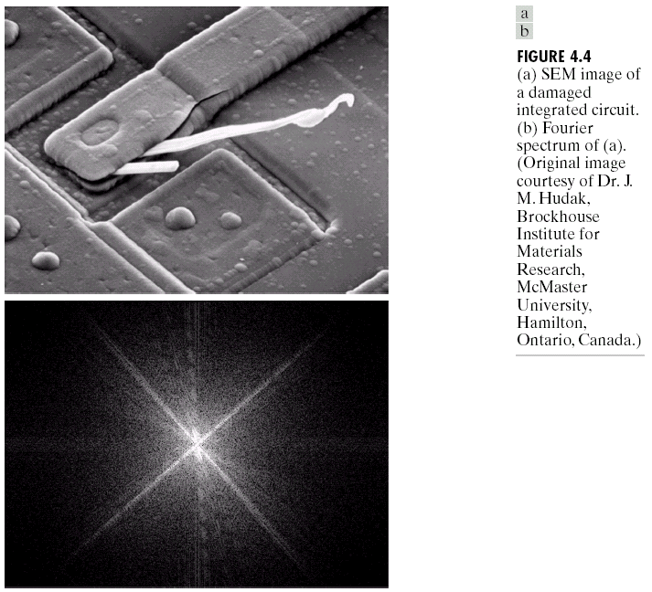
Image Processing

Slide 23
Image Processing
Low Pass Filter
  Allows low frequencies to pass
High Pass Filter
  Allows high frequencies to pass
Band Pass Filter
  Allows frequencies in a given range to pass
Notch Filter
  Suppresses frequencies in a range (attenuate)

Slide 24
Image Processing
High frequencies are more noisy
  Similar to the “salt and pepper” fleck on a TV
  Use a low pass filter to remove the high frequencies from an image
  Convert image back to spatial domain
  Result is a “smoothed image”

Slide 25
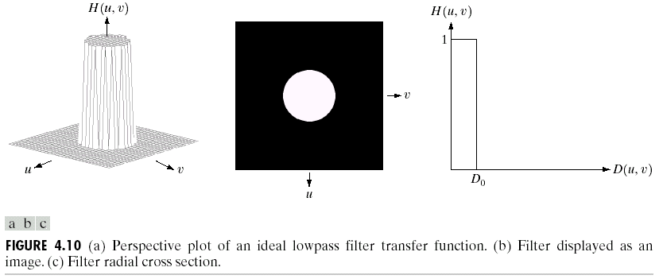
Image Processing

Slide 26
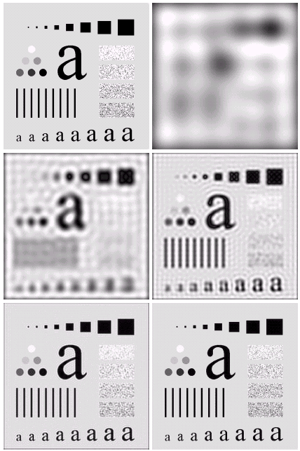
Image Processing

Slide 27
Image Processing
Image enhancement can be done with high pass filters and amplifying the filter function
  Sharper edges

Slide 28
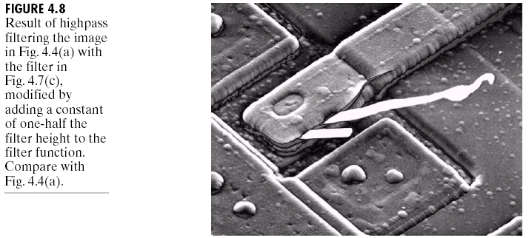
Image Processing

Slide 29
Image Processing
Transforming images to the frequency domain was (and is still) done to improve computational efficiency
  Filters were just like addition and subtraction
Now computers are so fast that filter functions can be done in the spatial domain
  Convolution

Slide 30
Image Processing
Convolution is the spatial equivalent to filtering in the frequency domain
  More computation involved

Slide 31
Image Processing
0 | -1 | 0
-1 | 4 | -1
0 | -1 | 0
50 | 50 | 150
50 | 50 | 150
50 | 150 | 150
 | -22.2
-50 – 50 + 200 – 150 – 150 = -200/9 = -22.2

Slide 32
Image Processing
By changing the size and the values in the convolution window different filter functions can be obtained
1 | 1 | 1
1 | 1 | 1
1 | 1 | 1
-1 | -1 | -1
-1 | 8 | -1
-1 | -1 | -1

Slide 33
Image Processing
After performing image enhancement, the next step is usually to detect edges in the image
  Edge Detection
  Use the convolution algorithm with edge detection filters to find vertical and horizontal edges

Slide 34
Computer Vision
Once edges are detected, we can use them to do stereoscopic processing, detect motion, or recognize objects
Segmentation is the process of breaking an image into groups, based on similarities of the pixels

Slide 35
Image Processing
-1 | -1 | -1
0 | 0 | 0
1 | 1 | 1
-1 | 0 | 1
-1 | 0 | 1
-1 | 0 | 1
Prewitt
-1 | -2 | -1
0 | 0 | 0
1 | 2 | 1
-1 | 0 | 1
-2 | 0 | 2
-1 | 0 | 1
Sobel

Slide 36
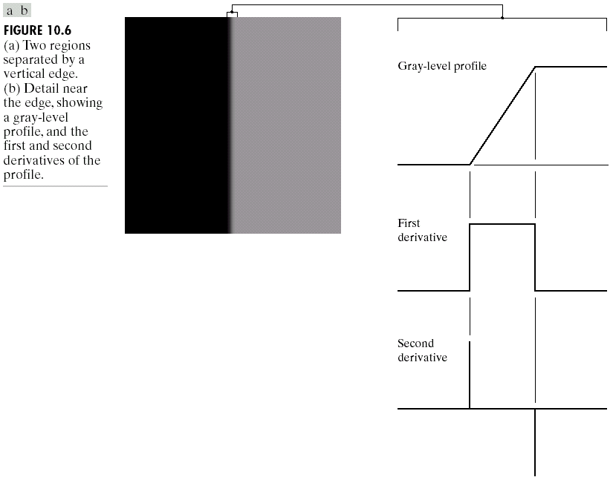
Computer Vision

Slide 37
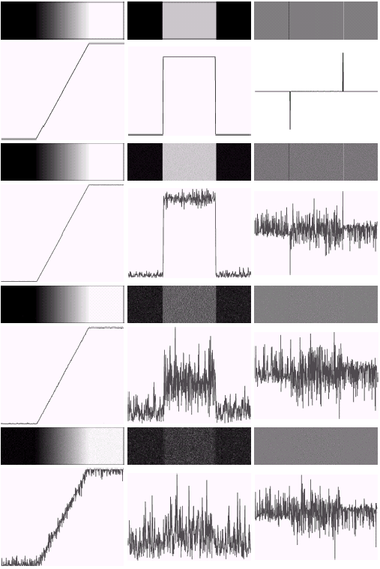
Computer Vision

Slide 38
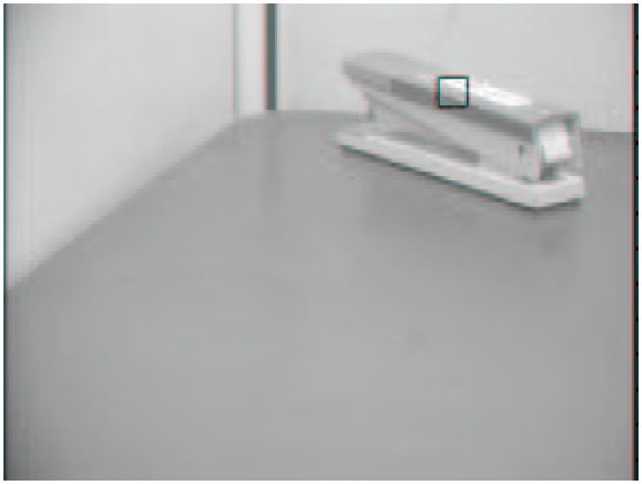
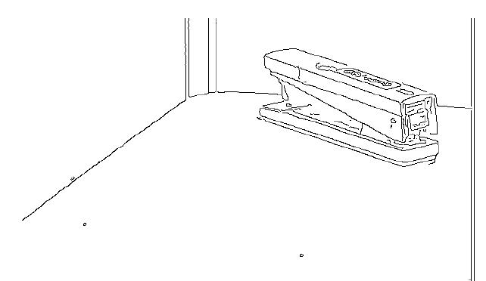
Image Processing

Slide 39
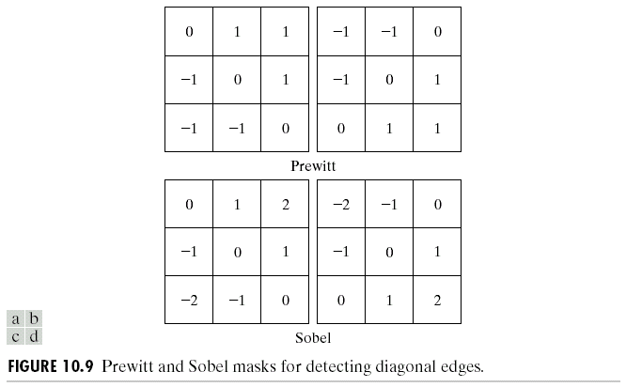
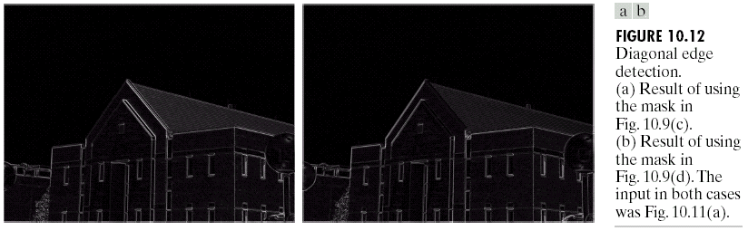
Computer Vision

Slide 40
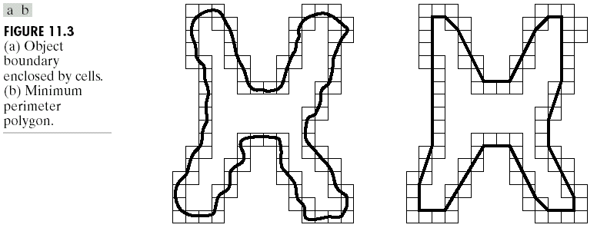
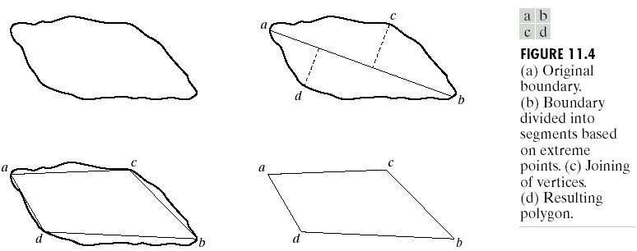
Computer Vision

Slide 41
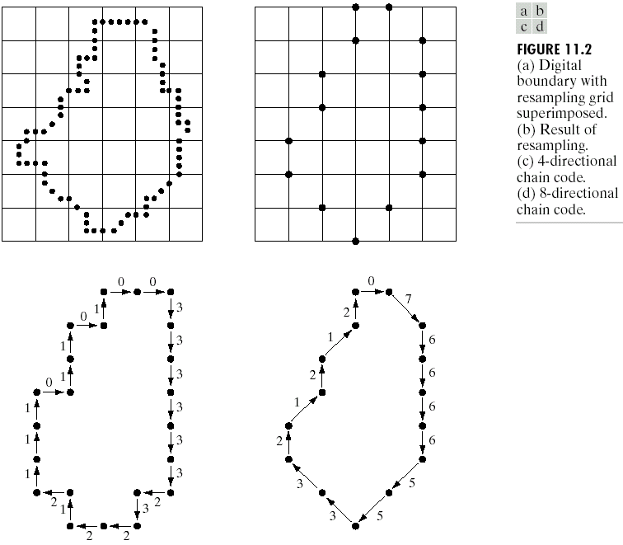
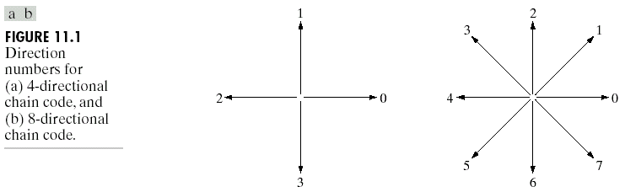
Representation and Description

Slide 42
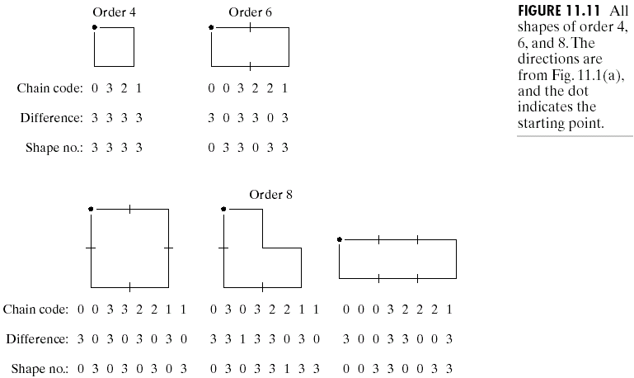
Representation and Description

Slide 43
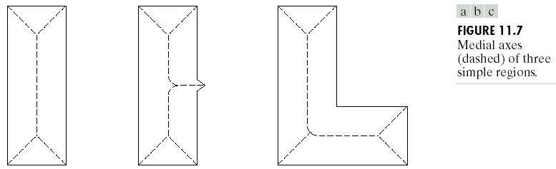
Computer Vision

Slide 44
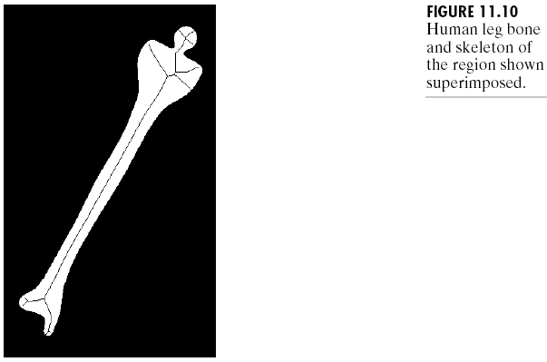
Computer Vision

Slide 45
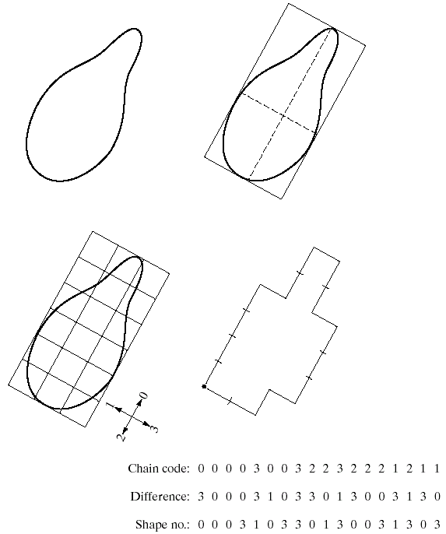
Representation and Description

Slide 46
Computer Vision
Contour Tracing
Connected Component Analysis
  When can we say that 2 pixels are neighbors?
  In general, a connected component is a set of black pixels, P, such that for every pair of pixels p_{i} and p_{j} in P, there exists a sequence of pixels p_{i}, ..., p_{j} such that:
    all pixels in the sequence are in the set P i.e. are black, and
    every 2 pixels that are adjacent in the sequence are "neighbors"

Slide 47
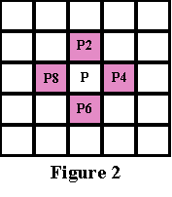
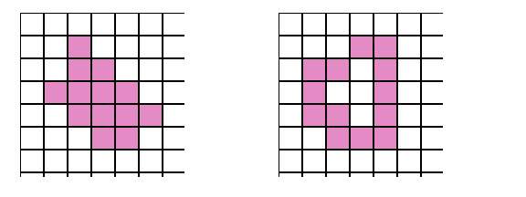
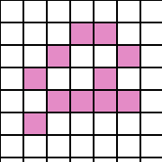
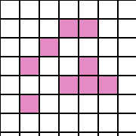
Computer Vision
4-connected
regions
not 8-connected
region
8-connected
region

Slide 48
Representation and Description
Topological descriptors
  “Rubber sheet distortion”
    Donut and coffee cup
  Number of holes
  Number of connected components
  Euler Number
    E = C - H

Slide 49
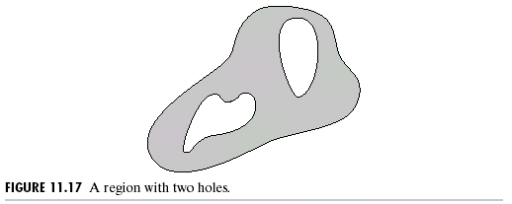
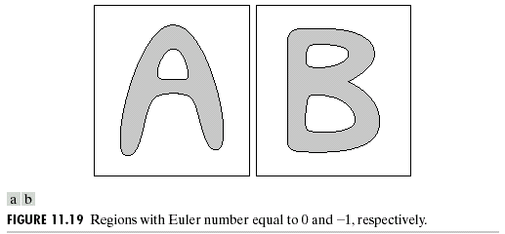
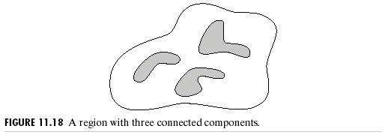
Representation and Description

Slide 50
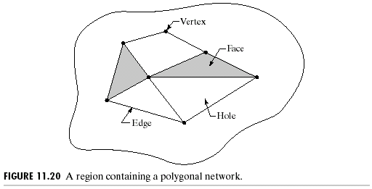
Representation and Description
Euler Formula
  W – Q + F = C – H
    W is number of vertices
    Q is number of edges
    F is number of faces
    C is number of components
    H is number of holes
  7 – 11 + 2 = 1 – 3 = -2

Slide 51
Object Recognition

Slide 52
Object Recognition
L-Junction
  A vertex defined by only two lines…the endpoints touch
Y-Junction
  A three line vertex where the angle between each of the lines and the others is less than 180º
W-Junction
  A three line vertex where one of the angles between adjacent line pairs is greater than 180º
T-Junction
  A three line vertex where one of the angles is exactly 180º
An occluding edge is marked with an arrow, →
  hides part from view
A convex edge is marked with a plus, +
  pointing towards viewer
A concave edge is marked with a minus, -
  pointing away from the viewer

Slide 53
Object Recognition
L
b
W
→
b
W
f
L
→
f
f
+
→
+
→
→
b
W
L
+
-
b
f
→
+
T
L
b
f
Y
→
b
f
+
→
L
b
→
L
b
W

Slide 54
Object Recognition
Object Base
flat
curved
# of Surfaces
1
2
6
10
Generating Plane
triangle
rectangle
Parameter
Formulas
rectangular
parallelpiped

Slide 55
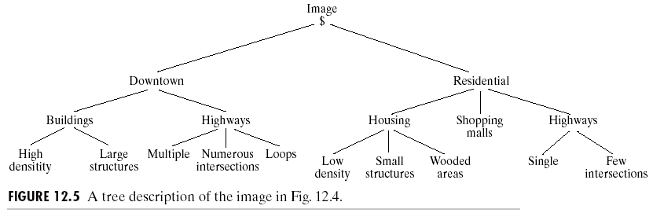
Object Recognition

Slide 56
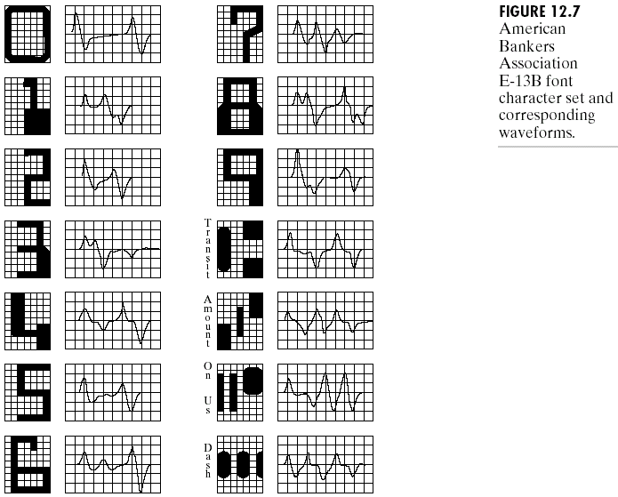
Object Recognition

Slide 57
Object Recognition
Shape context matching
  Basic idea: convert shape (a relational concept) into a fixed set of attributes using the spatial context of each of a fixed set of points on the surface of the shape.

Slide 58
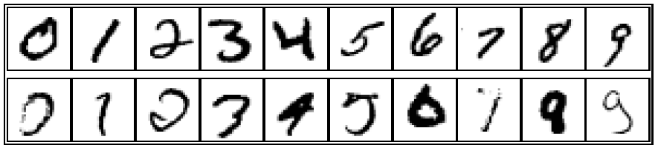
Object Recognition

Slide 59
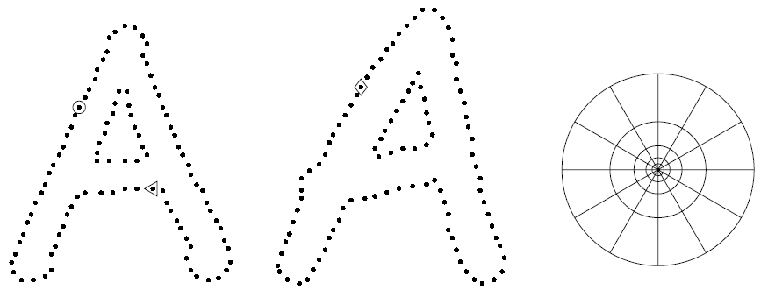
Object Recognition

Slide 60
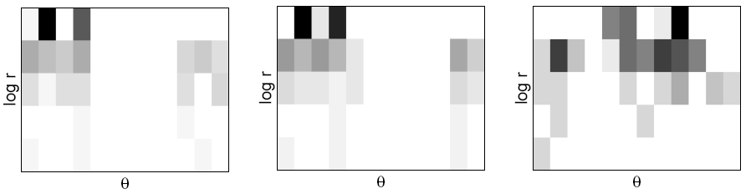
Object Recognition
Each point is described by its local context histogram
  (number of points falling into each log-polar grid bin)

Slide 61
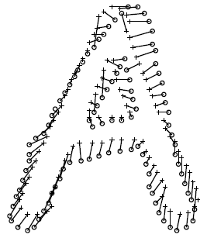
Object Recognition
Determine total distance between shapes by sum of distances for corresponding points under best matching

Slide 62
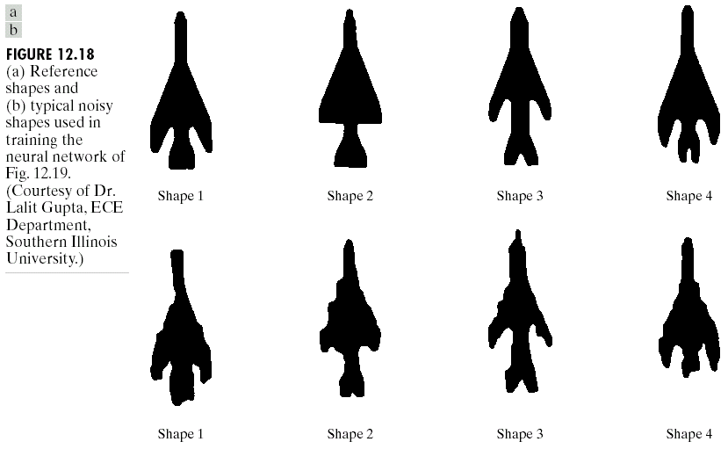
Object Recognition

Slide 63
Summary
Computer vision is hard!!!
  noise, ambiguity, complexity
Prior knowledge is essential to constrain the problem
Need to combine multiple cues: motion, contour, shading, texture, stereo
“Library" object representation: shape vs. aspects
Image/object matching: features, lines, regions, etc.

